Slide 1


Regional Rotary Foundation Institute 2011

Slide 2
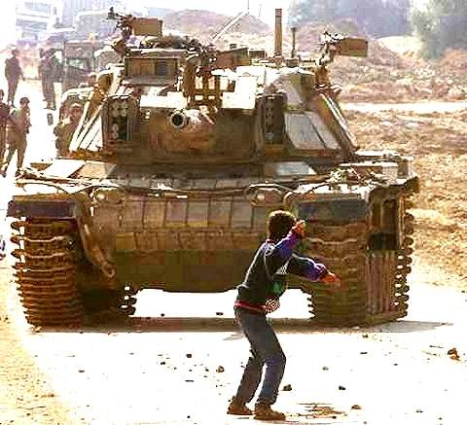

Slide 3
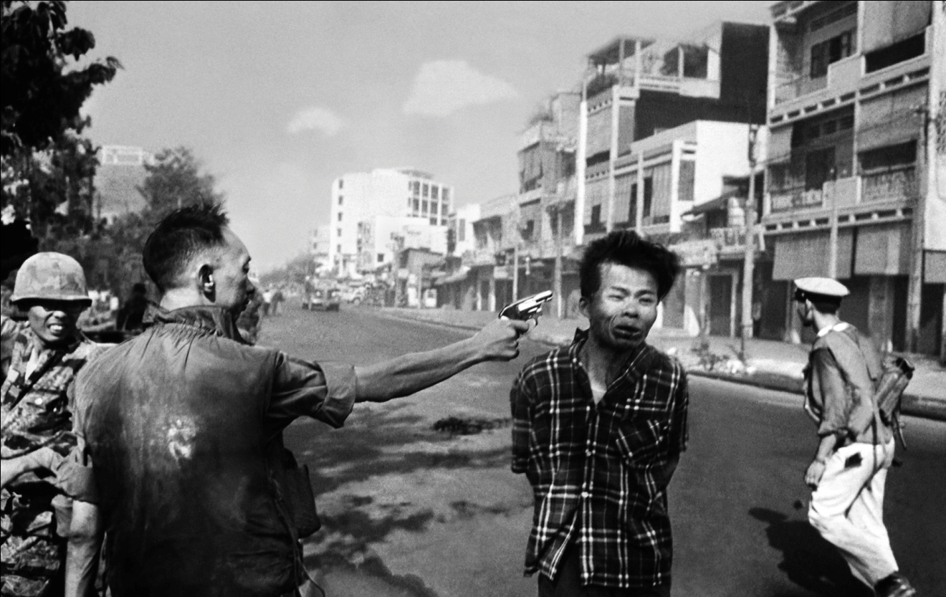

Slide 4
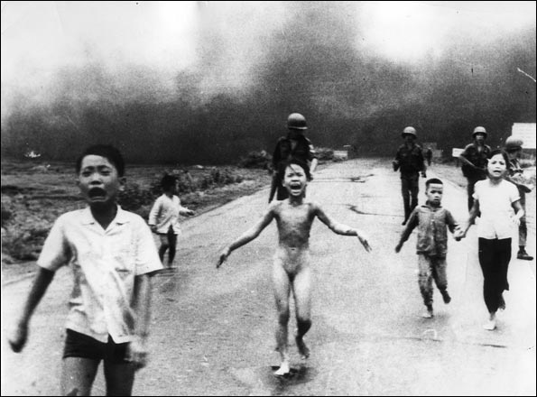

Slide 5
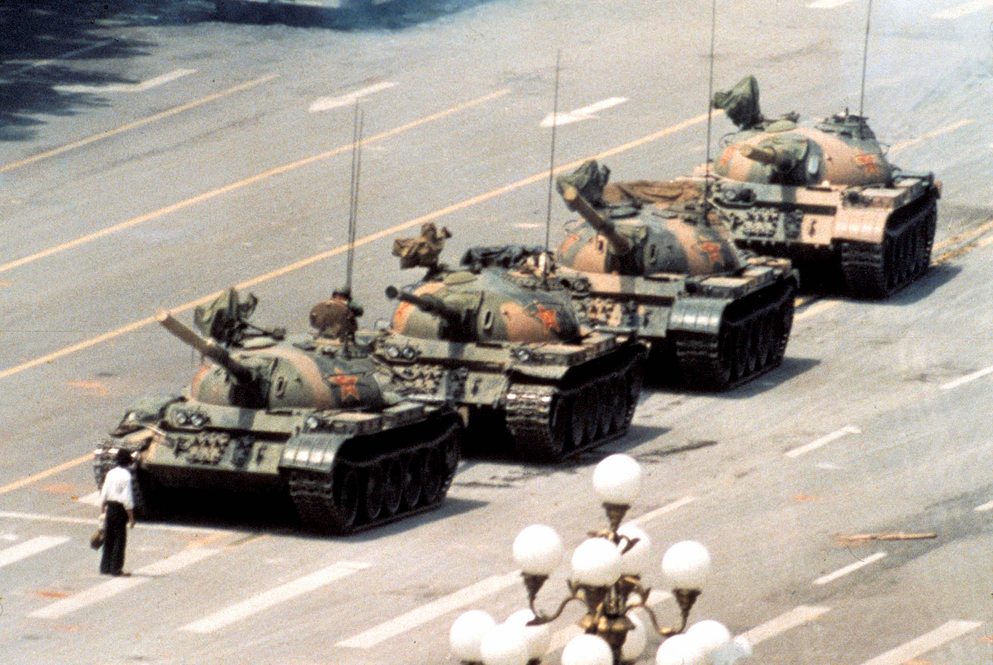

Slide 6
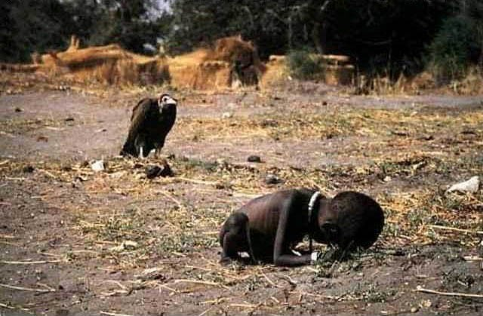

Slide 7
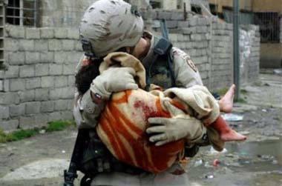

Slide 8
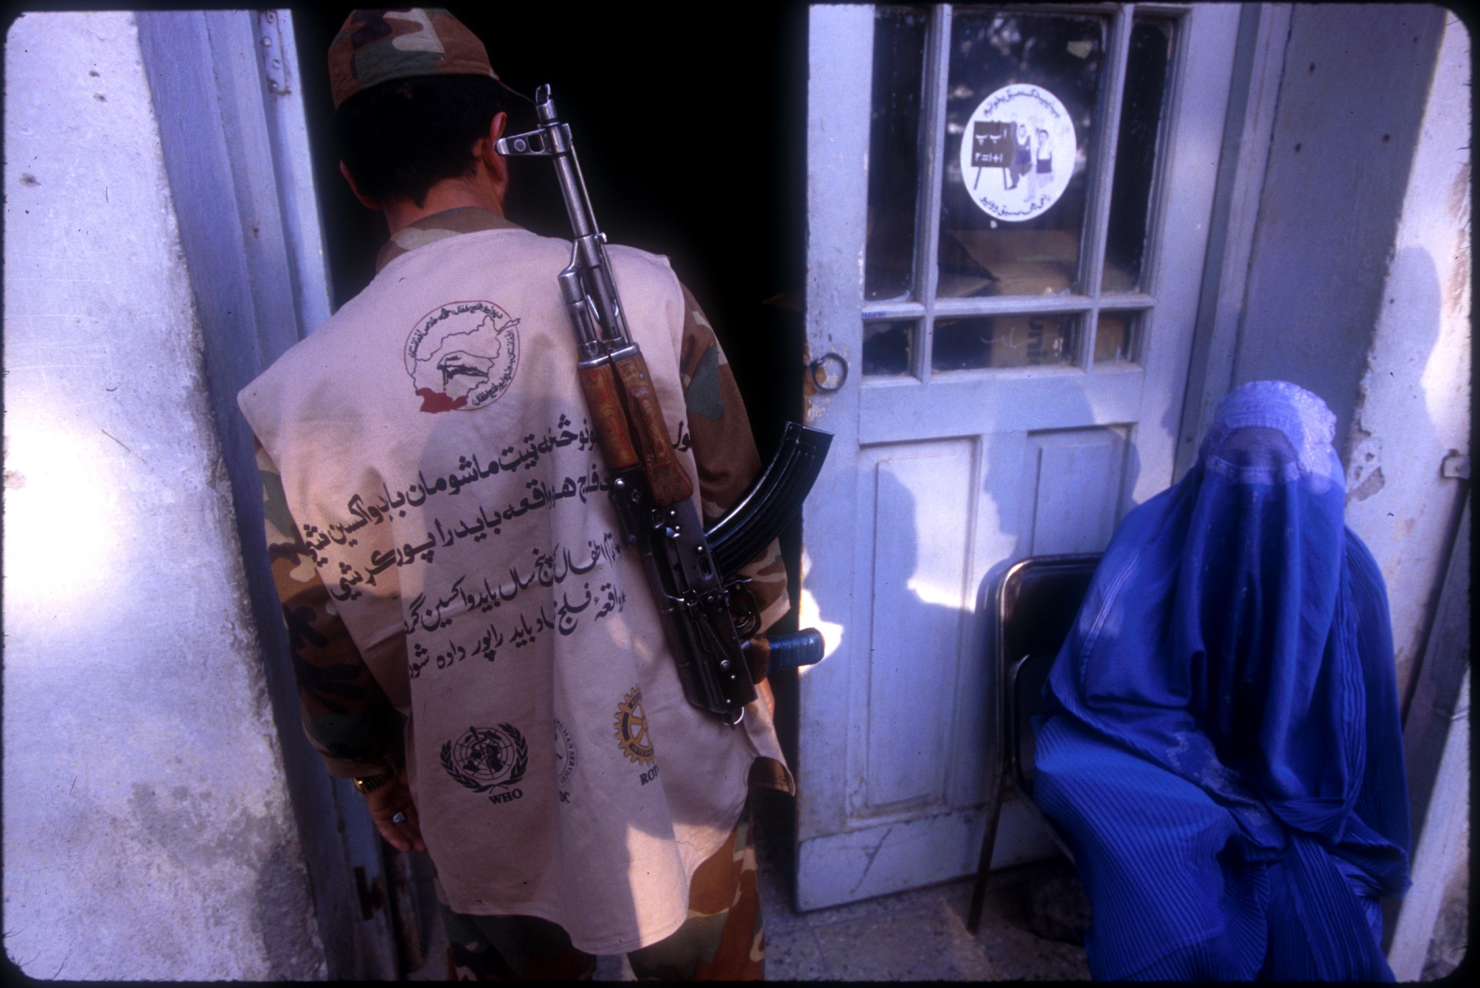

Slide 9
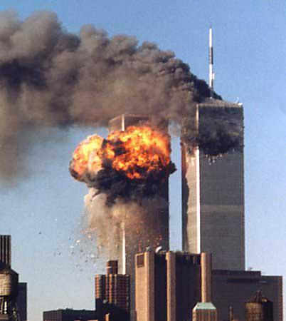

Slide 10


Slide 11

Rotary Peace Fellows 2009-10
Bradford University Rotary Peace Centre

Slide 12
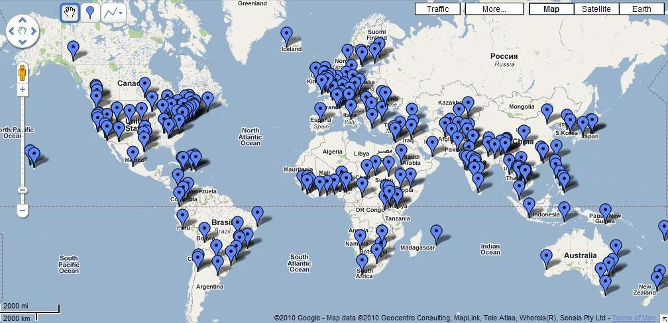
Rotary Peace Fellows – Cities where they work

Slide 13
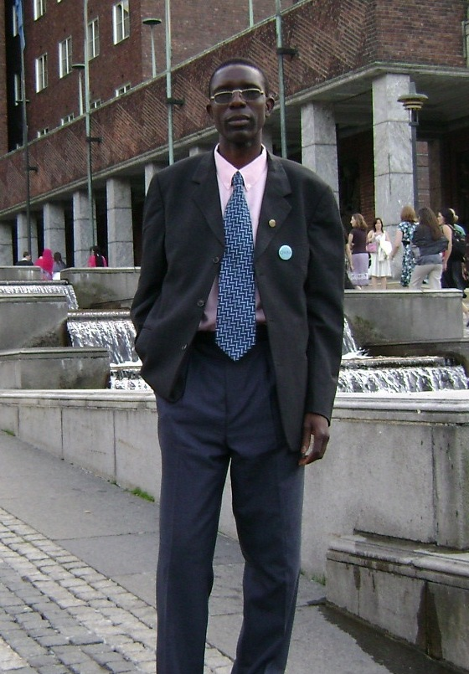
Francis Kabosha (Zambia)
(Paul and Jean Elder
Endowed Rotary Peace Fellow)
Chulalongkorn University, January 2007
University of Bradford, 2008-10

Slide 14
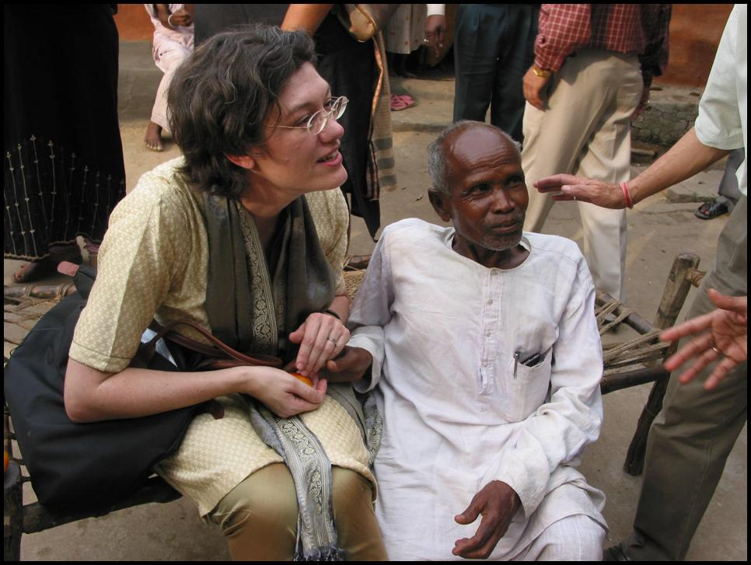
Elisabeth Abeson (USA)
International Christian University,
2003-05

Slide 15
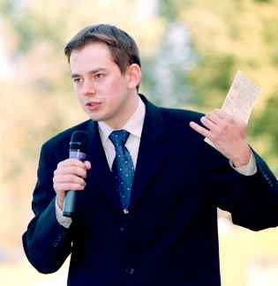
Arnoldas Pranckevicius (Lithuania)
Institut d’Etudes Politiques
(Sciences Po), 2002-04

Slide 17
YES,
PEACE
IS POSSIBLE

