Slide 1
FIGHTING POLIO – A Service Perspective
Jo Anne Settles, MSN, RN
Professor of Nursing, Victoria College
February 22, 2011
RRFC Training Institute
Notes:
Good afternoon – Thank you ____________. And thanks to all of you for allowing me to come here and talk about my favorite subject. I know some of you have heard many, many programs on polio that seem the same after awhile. So today I hope to recap the story of polio and Rotary and give you a new piece of information or two, and re-energize you to go back to your regions to invigorate other Rotarians around you. Polio is the Signature Program of Rotary – so let’s hear the rest of the story:……………….

Slide 2
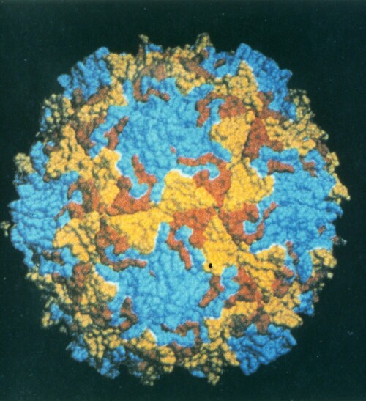
POLIO VIRUS
Notes:
For the past 4000 years, this tiny virus has killed and crippled millions of children. This is a microscopic photo of the wild virus. THIS, Ladies and Gentlemen, is our enemy.

Slide 3
Governments of The World
Notes:
Our Global partners are The World Health Organization, UNICEF, and The Centers for Disease Control. In a really simplified summary: the WHO organizes the efforts and schedules the NID’s, UNICEF acts as the purchasing agent to acquire the polio vaccine and distributes it to the places scheduled by WHO, the CDC is the technical expert to provide the science of confirming the diagnosis of polio cases among other services, and RI provides a good portion of the funds and many thousands of volunteers. But more than that, Rotary provides the tenacity to keep the effort going and get the job done The Governments of the world are giving lots of money in support and policies which enhance the effort.
As a result, 5 million children who might have had polio are now walking and playing normally.

Slide 4
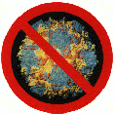
What is Polio? -- 1^{st:} it is incurable
A virus that enters the body through the mouth and throat,
Reproduces in the intestines,
Moves into the blood stream and throughout the body
Causes paralysis, usually of the lower limbs
Sometimes infects the base of the brain causing paralysis of the respiratory centers
Notes:
First – it is incurable; we do not CURE polio. BUT we do prevent polio. So, what is it?
It is very often a “silent” infection: mild flu-like symptoms and is EASILY transmitted unknowingly.
* A virus that enters the body through the mouth and throat, which then
* Reproduces in the intestines,
* Moves into the blood stream and throughout the body
* Causes paralysis, usually of the lower limbs
* Sometimes infects the base of the brain causing paralysis of the respiratory centers

Slide 5
Polio’s Three Viruses
Type 1 – the most dangerous, most spreadable, most paralyzing
Type 2 – weakest – in fact, GONE from the face of the earth
Type 3 – common, easier to control and eliminate, less devastating
Notes:
There are:
Three serotypes: P1, P2, P3 It is a transient flora of gastrointestinal tract
Type 2 is gone from the earth
Type 3 is less devastating and easier to control. It is opportunistic, arising when we work on Type 1 mainly
Type 1 is the most dangerous, most spreadable, most paralyzing

Slide 6
Poliovirus Characteristics
Transmission
Fecal-oral
Poor sanitation increases transmission;
HOWEVER:
Reservoir
Human – only; does not replicate anywhere else
Notes:
Transmission is fecal-oral. Poor sanitation increases transmission. However, the ONLY place the virus reproduces is in the human body. It can live in the soil until it dies, but it does not reproduce in the soil. Once we eliminate the only place the virus can replicate, we will eliminate wild virus polio. The way to do that is to vaccinate “every” person to take away the habitat. We often work on projects to protect the habitat of various species…..not this time.

Slide 7
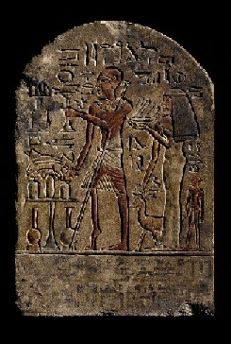
1350 BC- an early Egyptian stone carving depicts a priest with a withered leg, leaning on a staff, suggesting polio has been endemic for thousands of years
Notes:
Lets look first at the history of the problem: There is evidence from 1350 BCE (before common era) stone carvings of Egypt that polio has been endemic for thousands of years.

Slide 8
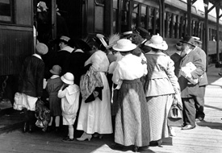
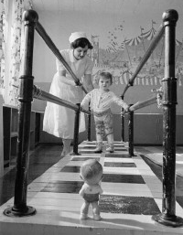
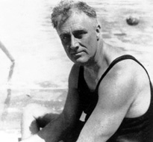
1916 – New Yorkers flee to the country to evade the epidemic
1921 – FDR gets polio
1927 – Warm Springs opens, makes braces & offers physical therapy
Notes:
1916 New York 27,000 paralyzed; 9,000 died, in panic they get on trains to leave the city and get away from each other. Interestingly, in some places they could not get off the train – towns said “Don’t stop here with your diseases.”
1927 FDR contracts polio
1927 – sooo! many people needed help that Warm Springs opened just to make braces. Warm Springs is still a premier Rehabilitation company in many parts of the US

Slide 9
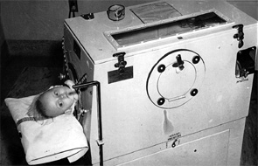
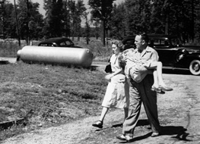
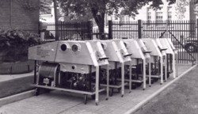
1937 – frantic ride to the
hospital with a feverish,
limp child
1932 –earliest iron lung
Other homemade iron lungs
Notes:
1932 – This early square iron lung helps the person breath by acting as a bellows to open the lungs.
1937 – the worst parents’ nightmare of the time: child awakens with headache, vomiting, constipation, and then fever and flaccid limbs. When they try to get out of bed, they fall down on the floor…because their legs do not work – polio has struck. For some – in only hours they are living in an iron lung

Slide 10
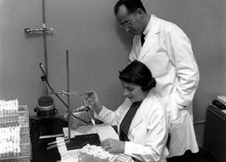
1947 – Salk vaccine work begins
Notes:
After the end of World War II, Jonas Salk received one of the first grants to begin work on vaccine development

Slide 11
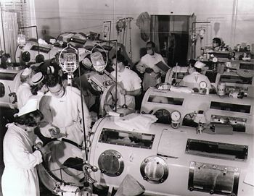
Rancho los Amigos Medical Center, Downey Ca 1952
Notes:
Soon – the epidemic spread and there were wards of lungs like this one

Slide 12
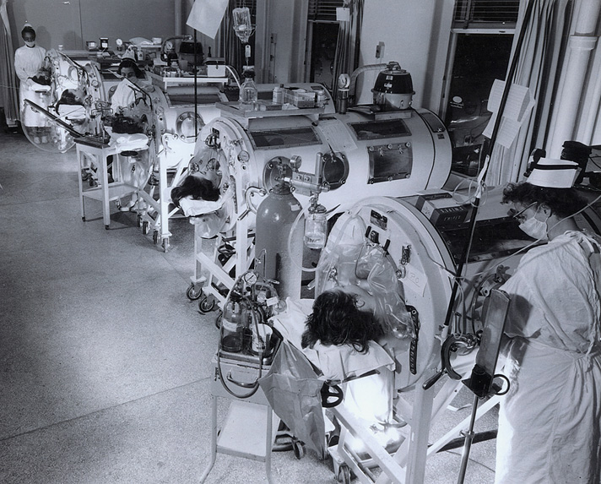
Notes:
Or this one

Slide 13
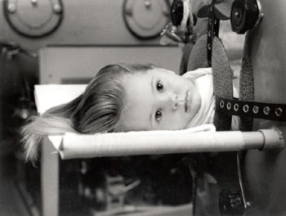
1952 – 558,000 US cases
Notes:
Not all cases are bulbar, (affecting the respiratory system), but thousands are left permanently afflicted.
Here is a typical child – notice the EYES – how poignant

Slide 14
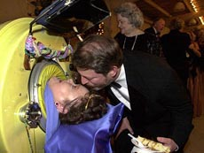
And some are still there…. 50 yrs later
Notes:
This could be the same girl – who knows…..there are still a handful of persons who live in their iron lungs today. They prefer this to the uncertainty of moving to some other type of portable respiratory assistance equipment

Slide 15
Vaccine Facts:
Salk Vaccine – is a dead virus
Is given in a shot
takes multiple doses
Notes:
The differences between the two vaccines are important ones:
The Salk vaccine is a dead virus; is given in a shot and takes multiple doses to gain immunity.

Slide 16
Sabin Vaccine – is a modified live virus
Is the Oral vaccine
Can be efficient with even one dose; we often give many doses when children suffer high levels of dysentery
Easy to give in large groups
Notes:
The Sabin vaccine is a modified live virus. It is given orally. Oral is better for large mass immunization efforts like the National Immunization Days we carry out now in Africa and the Middle East
***High levels of dysentery will require children to have multiple doses – sometimes 8 – 10 even…..because the diarrhea takes the vaccine right through the person without time to set up immunity.

Slide 17
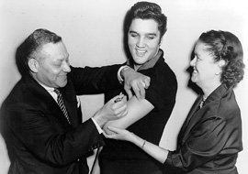
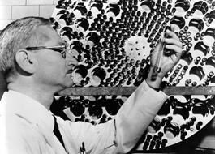
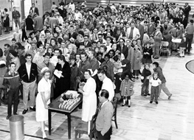
1957 – Sabin develops oral vaccine
1956 – Elvis joins the promotion
1961 – mass immunizations
with the newly approved
oral vaccine
Notes:
But now we have a vaccine and the campaign gets going
1956 Even Elvis joined in the act
1957 Albert Sabin develops an oral vaccine
1961 – mass efforts as you can see. How many recall the stacks and stacks of stainless trays with sugar cubes soaked in vaccine?
Actually in the 70’s, WHO recognized this as a world problem, not just industrialized countries. The OPV (oral polio vaccine) was introduced worldwide.

Slide 18
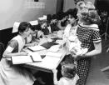
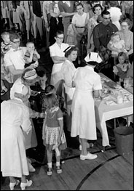
Notes:
More mass immunization campaigns

Slide 19
Where all this Rotary project started:
1977 – last case of smallpox
1979 - last case of polio in the US
1979 - polio outbreak in Philippines
Rotary Foundation looking for the BEST project for the 1st 3-H grant
Rotarians in the Philippines got that grant and eventually eradicated polio from that country
Notes:
But Where and how did Rotary choose this as an opportunity for service? Several things came together at the same time:
The end of smallpox is in Somalia – Edward Jenner had years before developed the first vaccines and now one disease is gone from the earth.
1979 last case of polio in the US and several other things happened at the same time:
1979 polio outbreak in the Phillippines
1979 – The RI Foundation want to make the selection of the first 3-H grant recipient. SO
Rotarians started this polio drive: in the Phillipines A severe outbreak occurred and the Rotarians thought we can help with this. The FIRST
3-H grant awarded went to this polio effort. The first 3-H grant – the first service perspective for polio was so successful !!

Slide 20
Where all this Rotary project started:
Rotarians think first an island, next the world and set out in 1985
1988 WHO declared this a worldwide initiative
Massive National Immunization Days (NID’s) held in Africa, Middle East, China, and others
Notes:
…..now, the seeds were sown – we will eliminate polio from the world.
Rotarians were the 1st who had the vision/dream of a polio free world. In 1985, the goal was set. Many of you have contributed to that and still are.
1988 – the World Health Organization finally caught up with us and figured out that this group – YOU Rotarians – were serious.
From there the Service Opportunity mushrooms: Massive National Immunization Days (NID’s) are held worldwide
Rotarians form the volunteer workforce and the spirit of the projects in every country.

Slide 21
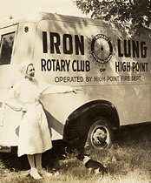
Notes:
Long before fund raising or National Immunization Days…..Fighting polio was already an Opportunity for Service - The Rotary Club of High Point has provided a portable Iron Lung vehicle.

Slide 22
Polio Cases Map 1988
1988
350,000 cases
125 countries
Notes:
So here is where we started – all the red countries – 125 of them - have endemic polio cases in 1988.

Slide 23
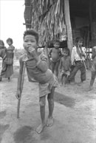
Cambodia 1988
Notes:
And the projects began –
Cambodia – you see this child was already stricken.

Slide 24
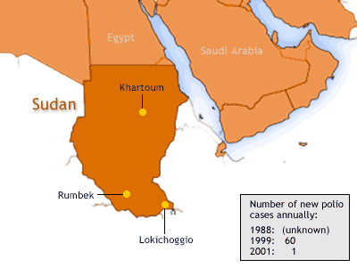
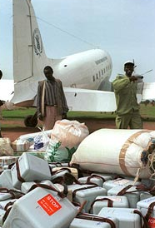
SUDAN
Notes:
Sudan – just south of Egypt on the map.
These coolers are being unloaded at a Sudanese airport – very important and critical part of the success of the campaign. The vaccine must be kept at a certain temperature and this is a part of that necessary cold chain

Slide 25
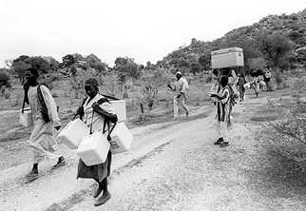
Notes:
Again you see the coolers and can see the importance they play.

Slide 26
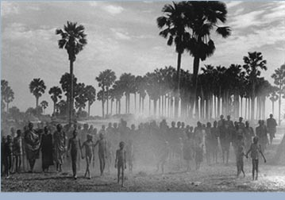
Rumbek, Sudan
Notes:
The day is set and the people come….
So much that they set up a dust storm as the masses walk to the immunization stations.

Slide 27
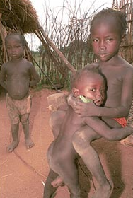
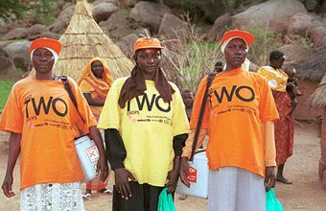
Notes:
The children and the volunteers. The TWO t-shirts indicate 2 drops of vaccine

Slide 28
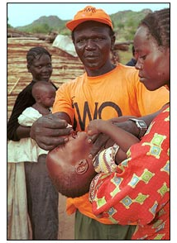
Notes:
George, a local vaccinator, administers an oral polio vaccine to a child. After years spent fighting in the civil war that has plagued Sudan for decades, Nubians like George are taking advantage of the recent ceasefire and returning to their villages. George has started a business, manufacturing and selling sesame oil, but doubles as a polio vaccinator during the polio vaccination campaign.

Slide 29
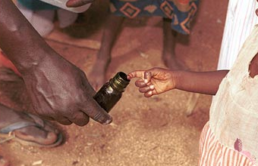
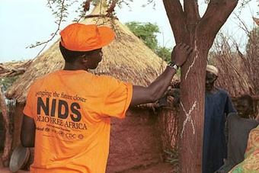
Marking the child and village already treated
Notes:
To ensure that every child under five has been vaccinated, children’s fingers are marked with gentian violet.

Slide 30
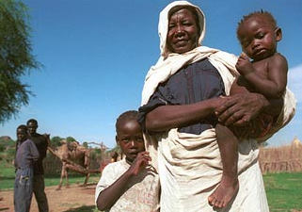
Notes:
This mother had her children vaccinated by vaccinators.

Slide 31
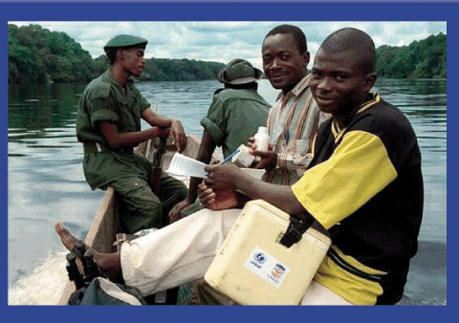
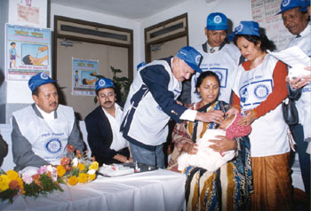
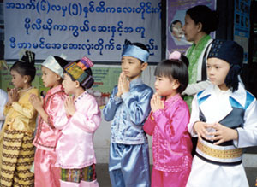
Nepal
Democratic Republic of the Congo
Myanmar
Notes:
Campaigns in Nepal, DRC, Myanmar – all countries now free of endemic polio, where there is some occurrence of imported cases.

Slide 32
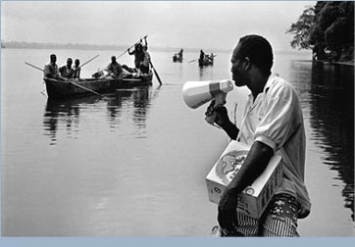
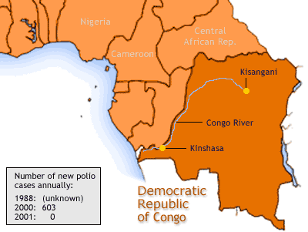
DRC
Notes:
All manner of transportation is used to reach the most remote areas.

Slide 33
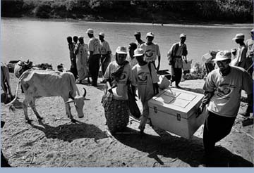
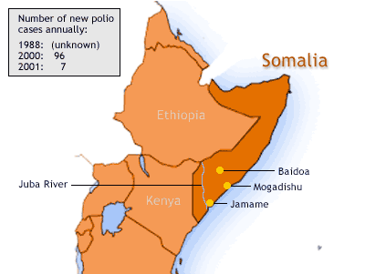
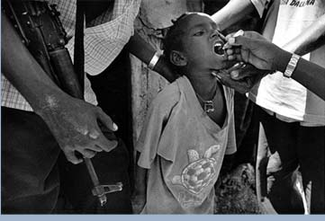
Somalia
Notes:
Somalia – remember the last case of smallpox was here. Actually the last human on earth to have smallpox was…..

Slide 34
The rest of the story…………
Ali Mao Maolim
Notes:
Who is a polio vaccinator because he does not want his country to be the last again

Slide 35
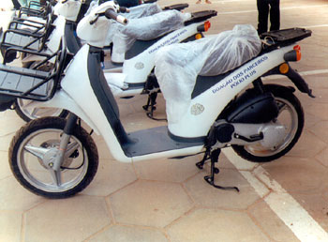
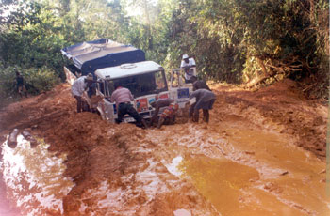
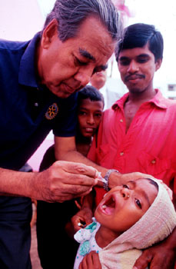
Angola
Liberia
Bangladesh
Notes:
Motorcycles and jeeps get through the mud to bring the miracle two drops of vaccine.

Slide 36
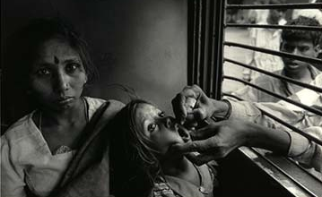
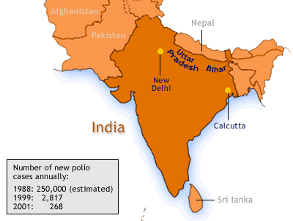
India
Notes:
Even at the train and bus stations, workers reach in to protect those who move about the country
The states of Uttar Pradesh and Bihar are the spots most at risk: difficult to access and they kept re-infecting each other

Slide 37
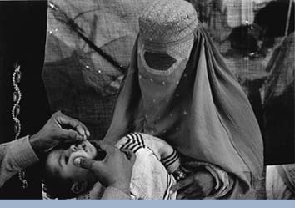
Afghan refugee camp in Pakistan
Notes:
Many persons have done an exemplary job in setting up polio stations immediately for the refugees as they cross back and forth across the border of the two countries.

Slide 38
Polio Eradication Progress
1988
350,000 cases
125 countries
Notes:
So here is where we started

Slide 39
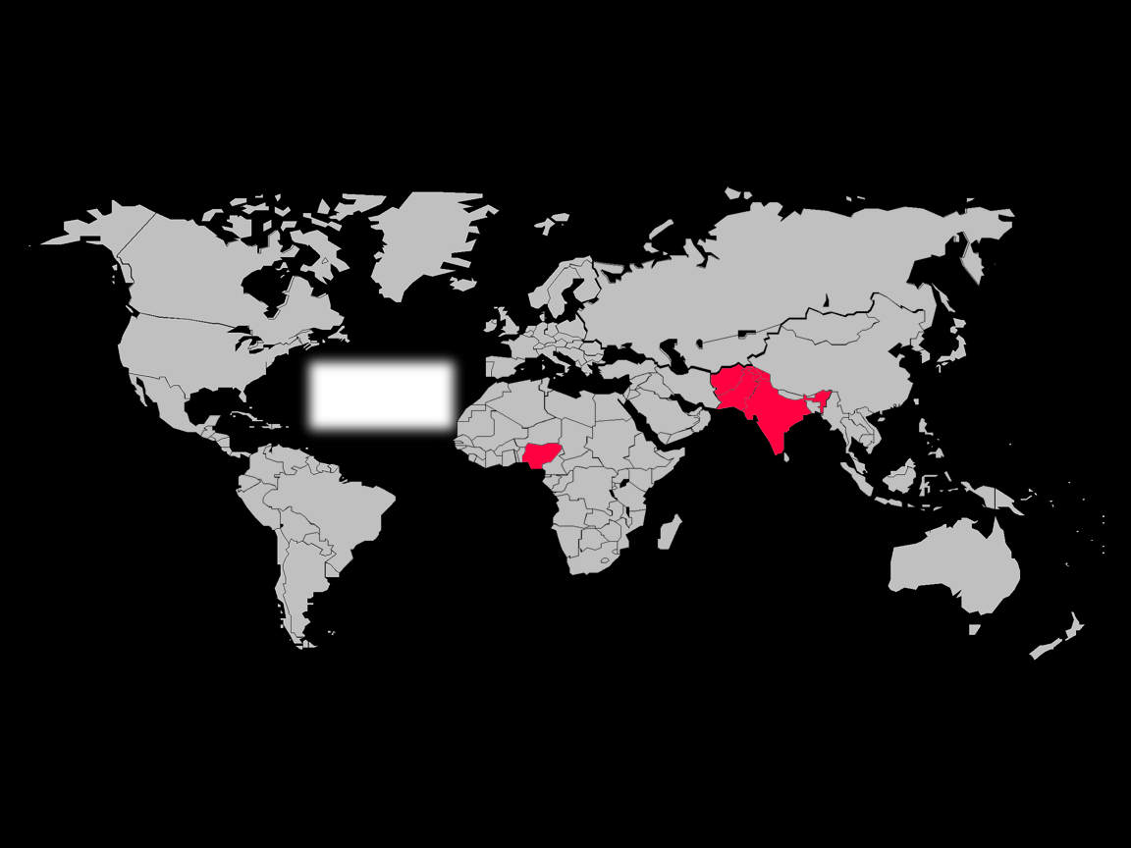
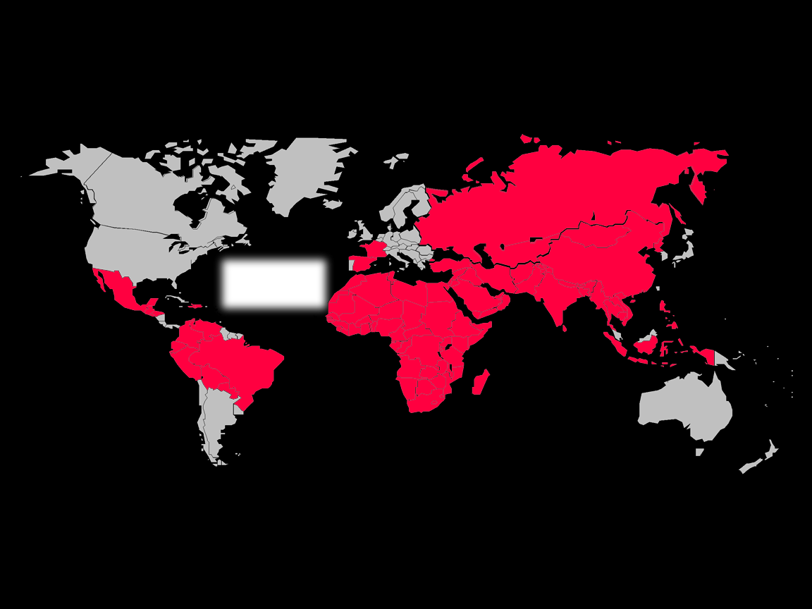
Progress in Polio Eradication
Notes:
What progress have we made? Lets see the countries turn from red to pink to white – leaving only the last endemic four: Afghanistan, Pakistan, India, and Nigeria

Slide 40
CHALLENGES
1.Accessing all the children
2. Sustaining the commitment
3. Continued
Funding
Notes:
Challenges – get to the kids, raise the money, keep up the effort

Slide 41
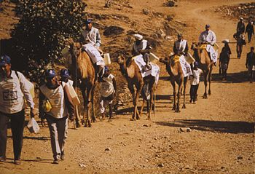
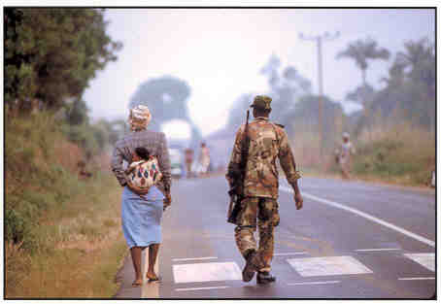
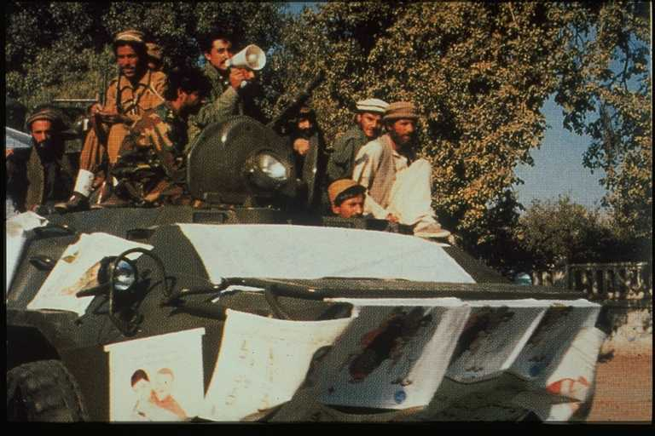
Accessing the Children
Live in extremely remote areas
Live in countries in civil war
Unreported cases of “flaccid limbs”
Notes:
You can see that camels, walking/hiking, or even military vehicles provide some of the ways of access to the extremely remote areas
We must continue to achieve cease-fires through political will. Rotarians are the best at this because they are not a political/ government body forcing the issue – they are forcing the governments and individuals to act. Often they are the only ones who can talk to a group without being suspected of having an ulterior motive beyond protecting children. Only Rotarians could have done this – take that message home to your clubs

Slide 42

Flooded lands in Bihar, India
Notes:
In the area of almost constant flooding in Bihar, access is especially difficult.

Slide 43

Major developments, India: logistics challenge in Kosi River Flood Plain
Kosi River flood plain
Type 1 Polio – 2007
Type 1 Polio – 2008
Type 1 Polio – 2009
Notes:
Here is where the rivers converge and need special access vehicles - hover craft.

Slide 44

Douglas Oberman
Notes:
At the Barcelona convention, a golden eagle award is given to Douglas Oberman, a 58 year old lawyer Rotarian from the US. He has had polio since age 8. How he ever got to Barcelona, I can’t imagine - it was obvious he struggled for enough air to talk and walked with effort, his arms hung useless at his side. The thing he said to those 25,000 gathered that I remember most was “My greatest fear is that some child will come up to me and say, ‘I am just like you, because Rotary did not finish it’s promise.’ Please don’t let that happen”

Slide 45


INDIA
Notes:
Our host, classmate District Governor Shashank is from Ahmadabad, in northwestern India, in the state of Gujurat.

Slide 46

Notes:
I know we would be in crowded areas. We saw: Congested traffic

Slide 47

Notes:
Cows and every other kind of beast you can imagine crowded the streets with carts, vehicles and people

Slide 48

Notes:
Makeshift tents along side every road, in town and out, in front of the most grand homes and apartments.

Slide 49

Ahmedabad West physical
therapy clinic
Notes:
There are many PT clinics because there are a lot of people with crippling polio. These were some of the vaccine stations during the NID. Other places to get the vaccine were temporary tables set up and street intersections, under street overpasses, at the train station and bus station. All in all, there were about 600 vaccine stations and several “mobile” groups– all manned by Rotarians – the service opportunity in action.

Slide 50

Use of PT clinic on Polio Day
Notes:
We stopped traffic in the streets and diverted them in to the clinic

Slide 51

Notes:
The poster and megaphone attached to those 3-wheelers did lots of promotion. These little things were everywhere, like ants; sometimes with 2 or 3 persons; sometimes with 12 hanging on. Today they were used to get people and their kids to the vaccines

Slide 52

Notes:
We traveled in a pair of two cars with 2000 doses of vaccine; stopping along the street where we saw groups of kids.

Slide 53

Notes:
I was amazed at their willingness to bring their children to a foreign stranger for the drops.

Slide 54

Notes:
Children gather around

Slide 55

Notes:
Here are those eyes again….this is the only place there was an orderly line – the teacher saw to it.

Slide 56

Notes:
Mostly there were just masses of people – they handed babies over each other’s heads and back

Slide 57

Notes:
As so went the 12 hour day – dose after dose

Slide 58

Notes:
This child did not take to well to being the photo op boy….

Slide 59

Notes:
The tents again – a newborn here about four hours old was cared for

Slide 60


Notes:
The cold chain: From the cooler to the cup with ice cubes, went each little vial until we needed it. This teenaged girl in one alleyway was eager to help

Slide 61

Notes:
Incentive gifts made the effort a little easier for them, someone from New York had sent some cookie treats – all children love a little treat.

Slide 62

Notes:
More biscuit cookies

Slide 63

Notes:
The EYES again -- Beautiful faces, bright eyes, proud individuals, doing all they could each day to provide for their families
These are the innocent – the curious, and the skeptically cautious

Slide 64

Notes:
Were willing to bring their children to a stranger, a foreigner, to get vaccine

Slide 65

Notes:
The people on the street recognize Mr. Polio and come eagerly

Slide 66


Notes:
Young children brought their younger siblings

Slide 67
How Did We Do?
164,150,254 vaccine doses given in one day across the country
Notes:
On the followup day in February, there were even more My brain cannot even quite get the enormity of this kind of numbers…..

Slide 68




New Tools: ‘monovalent’ polio vaccines
mOPV1
mOPV3
Countries using mOPV1 (22)
Notes:
Remember I told you about the 3 virus strains. The normal oral vaccine is a trivalent vaccine. The new ones are specific to Type 1 OR 3 and used in the appropriate area at the right time.

Slide 69
Newest Weapon
Bivalent Vaccine
Notes:
Our newest weapon is the bivalent vaccine for Types 1 and 3 combined. First used in Afghanistan in December 2009.

Slide 70
Protection after 2 doses of bOPV Clinical trial, India, 2009
p>0.05
p>0.05
Percentage
p<0.001
Superior to
tOPV & non-inferior
to mOPVs
p<0.001
Type 1
Type 3
Notes:
Bivalent vaccine has proved to be the best weapon to use to get the most benefit from each contact with a child. It is better than the trivalent and not inferior to the two monovalent vaccines.

Slide 71

New Saudi rules:
Notes:
New rules from countries - If you go on a pilgrimage to Saudi – you must present proof of polio vaccination or not enter the country.

Slide 72

New ‘Case for Completing Polio Eradication’
Routine immunization alone would result in 200,000+ children paralyzed by polio each year.
Polio “control” would cost more than eradication.
Notes:
72
Routine immunization alone would result in 200,000+ children paralyzed by polio each year.
Polio “control” would cost more than eradication.

Slide 73
Current Status (2010)
Endemic Countries
South East Asia: India – 42
Middle East: Pakistan – 144
Afghanistan – 25
Africa: Nigeria – 21
Non-Endemic countries - 742
TOTAL - 974
as of 23 February 2011
Notes:
73
(***These numbers may change with updated counts…………. Translator please read from slide…..)

Slide 74
Current Status (2011)
Endemic Countries
South East Asia: India – 1
Middle East: Pakistan – 8
Afghanistan – 1
Africa: Nigeria – 0
Non-Endemic countries - 13
TOTAL - 23
as of 23 February 2011
Notes:
Current status for 2011 – read slide for current numbers.

Slide 75

Notes:
These children do not need to be called the crawlers again or be part of the scorned of society

Slide 76

Notes:
They use their elbows and knees to pull themselves along, like an inch worm, to get places – the crawlers. This child is somewhat more fortunate – he can use his arms and hands.

Slide 77
We Must Continue
National Immunization Days (NID’S) continue
Funds must still be given
It is the last out of the last inning of the game – the very hardest part -- Dig deep into our resolve to finish this effort
Notes:
Continue the NID’s
Raise the funds
Pick your own analogy: Basketball playoff game in the third overtime, match play on the 18th hole, soccer match is tied and it is time for the shootout…Whatever it is that makes your pulse race and your stomach knot up – that is where we are.
BUT you are tired and it the hardest time to play even harder. I am sure that if you are watching the TV and your team is at this point, you are up yellin’ and hollerin’ for them to finish the game and WIN. …………….. Well, my friends – the children of the world are up and yellin’ and hollerin’ at you – please finish the race against POLIO!!!. Don’t let them down.

Slide 78
The children of the world are watching you and cheering you on, to give it your all
The children of the world are waiting for you to win the battle
Notes:
When the game is tied and it is the THIRD overtime…….when those boys get up play after play, just like your Rotarian colleagues in India do week after week – for 20+ years now……
Finally the play is called and the winning points are scored. YES, this will be you Rotarians and children of the world. Just as the exhausted fans and players celebrated, so we will we. But you must not let up now.

Slide 79
PolioPlus requires "no tolerance to lose"
Notes:
You must return to your clubs and districts and quiet those who are skeptical and reinforce that there is no room for negativity because we must all have the sense that there is “no tolerance to lose.”

Slide 80


Ray Klinginsmith 2010-2011
Building Communities
Bridging Continents
Notes:
President Ray urges to Build Communities and Bridge Continents – what better way than to complete our Polio Project, this Service Opportunity

Slide 81


Kalyan Banerjee 2011-2012
Notes:
Coming up we will be working with President Kalyan. He asks to Reach Within to Enhance Humanity. What better way to Reach Within than to look deep into our souls and hearts and pockets to complete the last minutes of the game

Slide 82

Notes:
These should be the last of the ones who need the braces and orthopedic surgery. We should never have to go back to…………

Slide 83

Notes:
THIS

Slide 84
Notes:
OR THIS
It is TIME – to kick that field goal, sink that putt, nail the 3 pointer, and hear the children of the world CHEER!
Take that message home to your clubs – and send your money…..

Slide 85

Fulfill Our
Promise:
Eradicate Polio !!!
Notes:
As we will fulfill the promise –

Slide 86

“We don’t let children die because it is fatiguing to save them.”
Notes:
In the words of Bill Gates “We don’t let children die because it is fatiguing to same them.”
Thank you again for letting me recap our project – and retell this incredible story….

Slide 87
Web Sites
www.polioeradication.org
www.endofpolio.org
www.cdc.gov
www.who.intl
www.marchofdimes.org
www.rotary.org/endpolio
www.americanhistory.si.edu/polio
Notes:
Some fantastic resource sites.
Other references include David Oshinsky’s Pulitzer Prize winning book, Polio, the American Story
And textbook, Microbiology for Nurses, 11th edition, by Frobisher, Sommermeyer, & Blaustein, 1965. (The current texts do not have much coverage of the polio virus…..) Quote from the text “With the widespread use of this vaccine, it would be interesting to conjecture on the eventual fate of polioviruses in the absence of susceptible intestinal tracts to infect!”

