Slide 1
INFORMATION SERVICES
Key Initiatives
Peter Markos

Slide 2
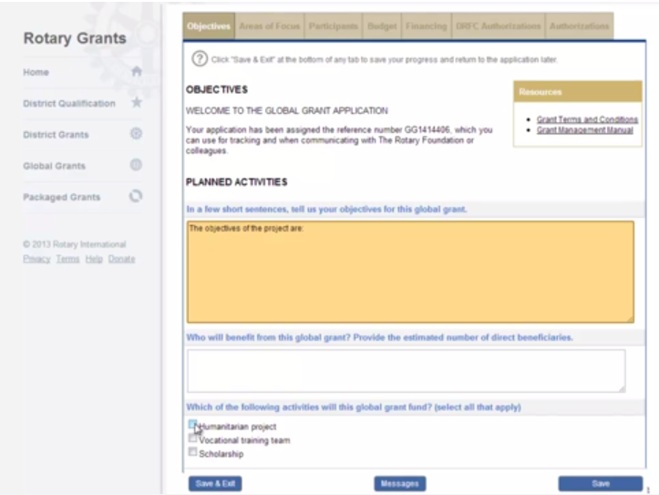
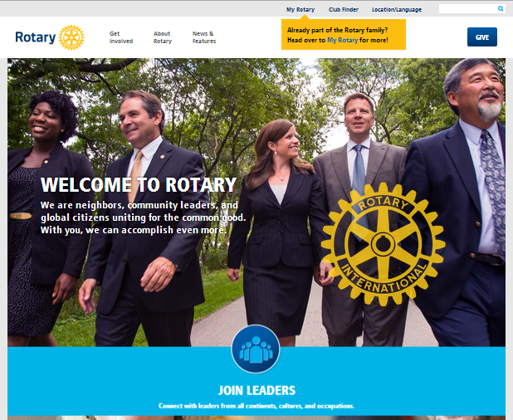
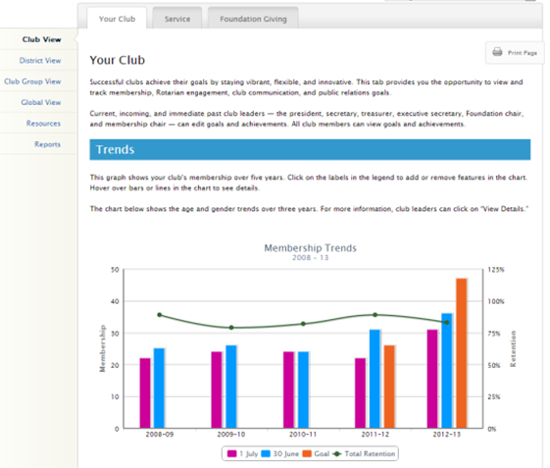
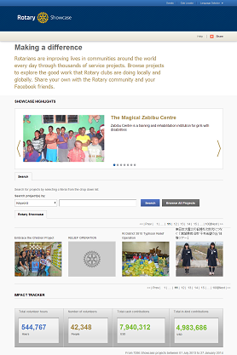
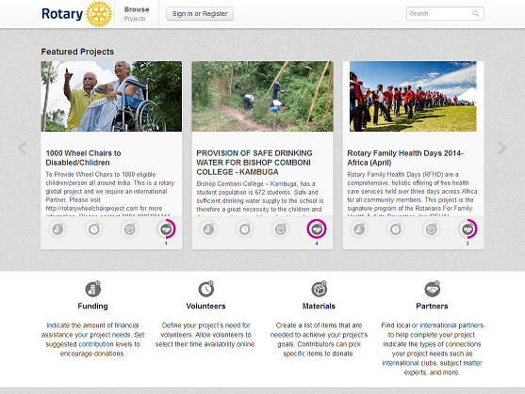
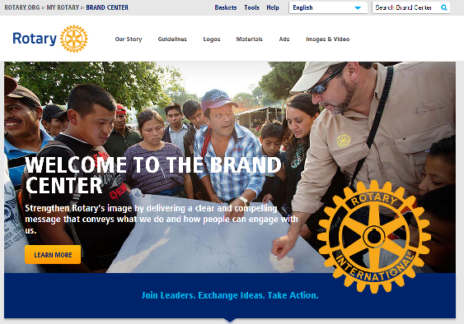
TECHNOLOGY CHANGES – GETTING IT RIGHT
Notes:
In the recent past we have rolled out to the Rotary World:
New Rotary.org / My Rotary
Future Vision – Online Grant Application
Showcase
Rotary Club Central
Idea Platform / Groups / Community features
Brand Center
Membership Sponsor program

Slide 3

TECHNOLOGY CHANGES – GETTING IT RIGHT
Rotarians are struggling to keep up. Our focus is on:
Adoption and barriers to adoption
Gathering feedback and refining
Ensuring clubs and members are getting value out of these tools
Notes:
Rotarians are struggling to keep up. Over the next 18 months, our focus is on:
Adoption and barriers to adoption
Gathering feedback and refining as appropriate
Ensuring clubs and members are getting value out of these tools

Slide 4
OPERATIONAL CHANGES
Over the next 18 months
Move to a Print on Demand model for publications
Customization of materials (if desired)
Outsource distribution and logistics where appropriate
Notes:
In the coming 18 months we plan to:
Move to a Print on Demand model for publications
Potentially allow customization of materials (if desired)
Outsource distribution and logistics where appropriate (globally)

Slide 5
OPERATIONAL CHANGES
We are doing these things to achieve:
Higher service levels for clubs and members
Increased efficiencies while lowering costs and waste for the organization
Increased flexibility and potential for increased revenue
Notes:
We are doing these things to achieve:
Higher service levels for clubs and members
Increase efficiencies while lowering costs and waste for the organization
Increase flexibility and potentially increase revenue with add-ons options

Slide 6
ACTION ITEMS
Adoption
Communication
Notes:
Hand off to Lori

