Slide 1
PROGRAMS AND MEMBER SERVICES
Michele Berg
6 March 2014

Slide 2
Programs & Member Services
Membership Development
Learning & Development
Meetings & Events
Programs & Grants
Member Services
Notes:
The Programs & Member Services team works with membership development, learning & development, meetings & events, programs, grants, and member services – Member services includes regional coordinator support team, the Rotary Support Center and club and district support…
So in summary our team comprises many of the programs and services that you might experience from contacting Rotary.
I would like to share a high level summary of the key initiatives of the group this year.

Slide 3
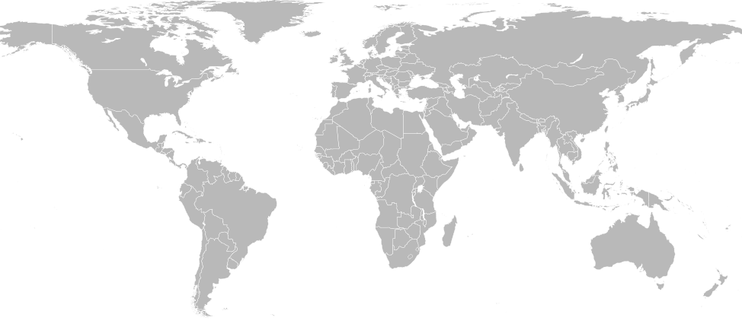
Membership Development
Notes:
3
3
3
3
Membership Development – regional membership plans. Membership is a CRITICAL priority for the organization and we have seen a much stronger focus on this in the last year or two.
A big shift for Rotary is that we used to approach membership globally – with standard campaigns that all countries, clubs and districts would be asked to implement consistently.
The RI Board has now approved a regional approach in recognition that one size does not fit all.
Board has authorized the creation of 22 regional plans so that we may address the varying needs for membership. Some areas have problems keeping members and some do not. Some areas have a very low concentration of Rotarians in the population and show potential for new members. Some areas are ripe for creating new clubs. E-clubs are a new strategy that work in some areas, but not all.
I think we are at a unique time in Rotary’s history. We’ve seen stagnant growth for 15 years worldwide and unfortunately, with a small decline in the last two Rotary years.
On the positive side… membership is a huge priority for President Ron, President-elect Gary Huang and even President-nominee Ravi Ravindran. And it has been for Past President Tanaka as well.
They are all consistent in their support for membership and they will be counting on all of us to support this key initiative.
You as regional coordinators are a critical partner in membership development. I thank you all for the time and energy you are putting in to supporting membership development.

Slide 4
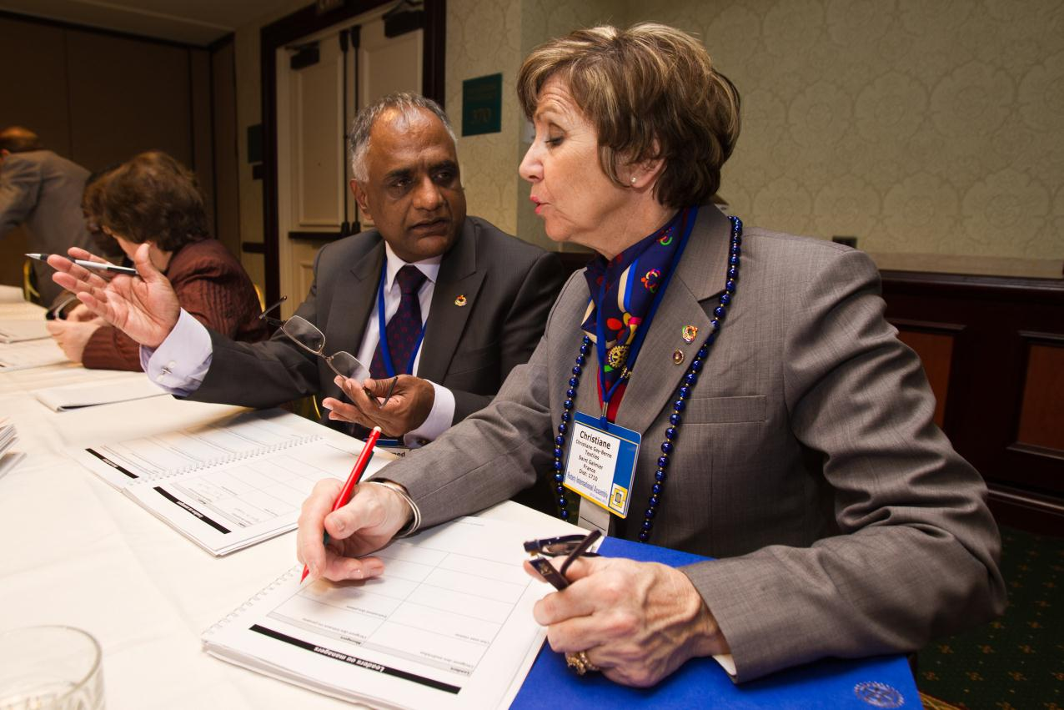
Learning & Development
Notes:
Learning & Development –
This team develops curriculum for training events – like this Coordinator Institute! And of course the most important initiative today is this event!
They also support the Convention, International Assembly, and there is a significant focus on webinars and elearning.
I should also mention that this team supports training on new initiatives for the organization (for example the Future Vision launch last year and the new visual identify for this year).

Slide 5
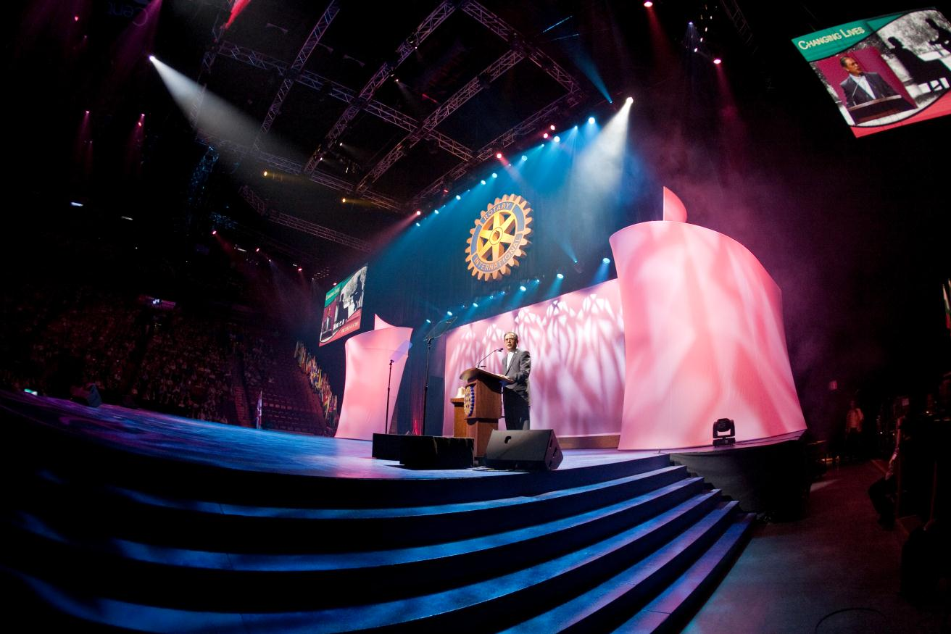
Meetings & Events
Notes:
Meetings & Events is the team which supports the logistics, registration, housing, stage production for events that range from 10 people to 40,000 people. They support the International Convention, Assembly and this event as well.

Slide 6
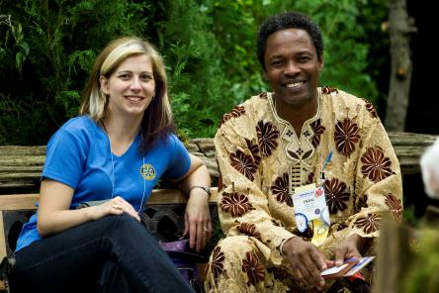
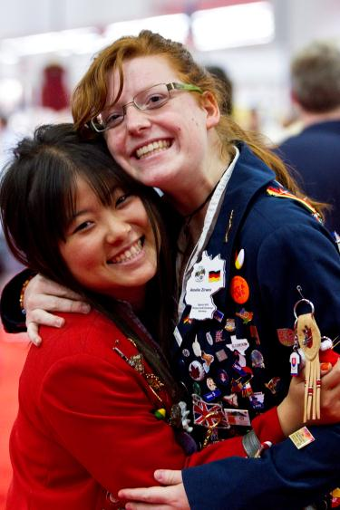
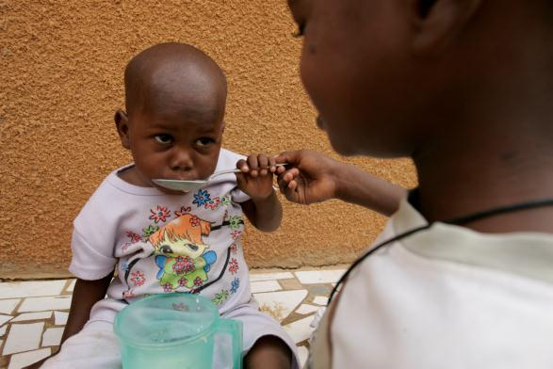
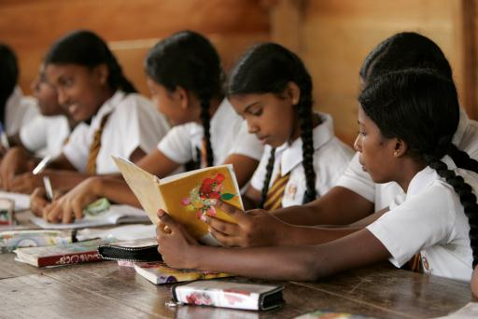
Programs & Grants
Notes:
Programs & Grants – a newer group combining both funded and unfunded programs. The idea is to support service from Rotary clubs, whether or not they receive a grant from The Rotary Foundation. The major focus for this group is the first year of the new grant model.

Slide 7

Member Relations
Notes:
Member Services – important initiative is the Regional Coordinator support of course! A focus this year is continued improvement of the Rotary Support Center (aka Contact Center). Abandon rates are down by 50% from last year, but we are still working to improve response times.

Slide 8

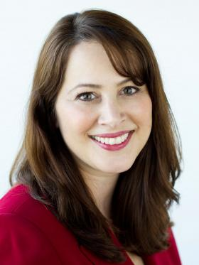
THANK YOU!
www.facebook.com/michele.berg.rotary
michele.berg@rotary.org
Find me on LinkedIn – Michele A. Berg
Notes:
Thank you for what you do in the field to strengthen Rotary clubs and districts. If I or my team can do anything further to support you, please contact me!

